Slide 1
Week 11: New AI Tools and Trends
The Full 2026 AI Landscape — Models · Agents · Coding Tools · Automation · Strategy
BUAN 6v99 — Generative AI for Business
University of Texas at Dallas | Spring 2026
April 8, 2026 | Professor Antonio de Pádua Paes Jr.

Slide 2
New AI Tools and Trends
BUAN 6v99 — Generative AI for Business
Class 11 | University of Texas at Dallas | Spring 2026
Professor: Antonio de Pádua Paes Jr.
"We are not in a period of gradual improvement. We are in a period of compounding transformation — where every month rewrites what's possible."
Today we cover five sections:
• The AI model landscape in early 2026 — who's leading and why
• AI agent frameworks — how AI now takes actions, not just answers questions
• AI coding tools — Claude Code, Cursor, Copilot, Windsurf compared
• Business automation and multimodal AI — n8n, Make, Zapier, video generation
• Key trends — RAG, fine-tuning, building your AI stack, career outlook
1

Slide 3
Today's Agenda
Class Overview — 2 Hours
# | Section | Topics | Time
1 | AI Model Landscape | GPT, Claude, Gemini, DeepSeek, Llama — what's new and how to choose | 25 min
2 | AI Agent Frameworks | Claude SDK, OpenAI Agents, LangGraph, CrewAI, MCP protocol | 25 min
3 | AI Coding Tools | Claude Code, Cursor, Windsurf, GitHub Copilot — live comparison | 20 min
4 | Business Automation | n8n, Make, Zapier AI, vision/audio/video — real workflows | 20 min
5 | Key Trends | RAG 2026, fine-tuning access, your AI stack, career paths | 20 min
Wrap-up: Building your personal AI stack + homework preview
What's different about this class: We're not just surveying tools — we're building judgment about when to use each one, at what cost, and for what business outcome.
2

Slide 4
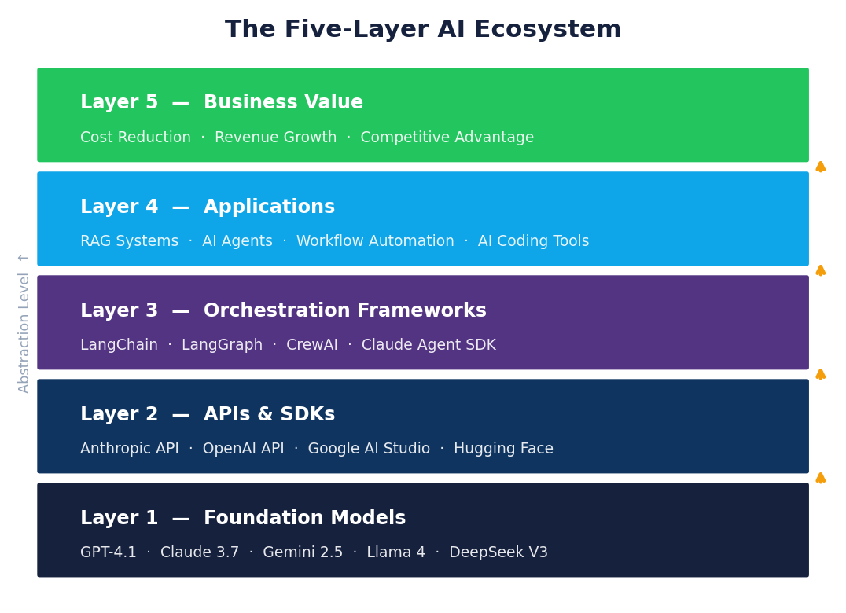
The Five-Layer AI Ecosystem
How the Industry Organizes Itself
Layer | What It Is | Key Players | Where Value Lives
Layer 5: Applications | End-user products people interact with daily | ChatGPT, Claude.ai, Gemini, Perplexity, Copilot | User experience + workflow integration
Layer 4: Agent Frameworks | Orchestration of multi-step AI workflows | Claude Agent SDK, OpenAI Agents, LangGraph, CrewAI | Business process automation
Layer 3: Integration Tools | Connecting models to data and external systems | MCP, LangChain, LlamaIndex, RAG Pipelines | Enterprise data access
Layer 2: Foundation Models | The raw intelligence — trained on massive data | GPT-4.1, Claude 3.7, Gemini 2.5, Llama 4, DeepSeek | Capability benchmarks
Layer 1: Infrastructure | Compute, cloud, and specialized AI chips | NVIDIA H100, AWS, Azure, GCP, Groq | Speed and cost
The critical insight for business strategists:
• Layers 1 and 2 are rapidly commoditizing — multiple providers offer similar capability at falling prices
• Competitive advantage has moved to Layers 3, 4, and 5 — how you connect AI to your data and workflows
• The companies winning in AI are not the ones with the best models — they're the ones with the best integration
3

Slide 5
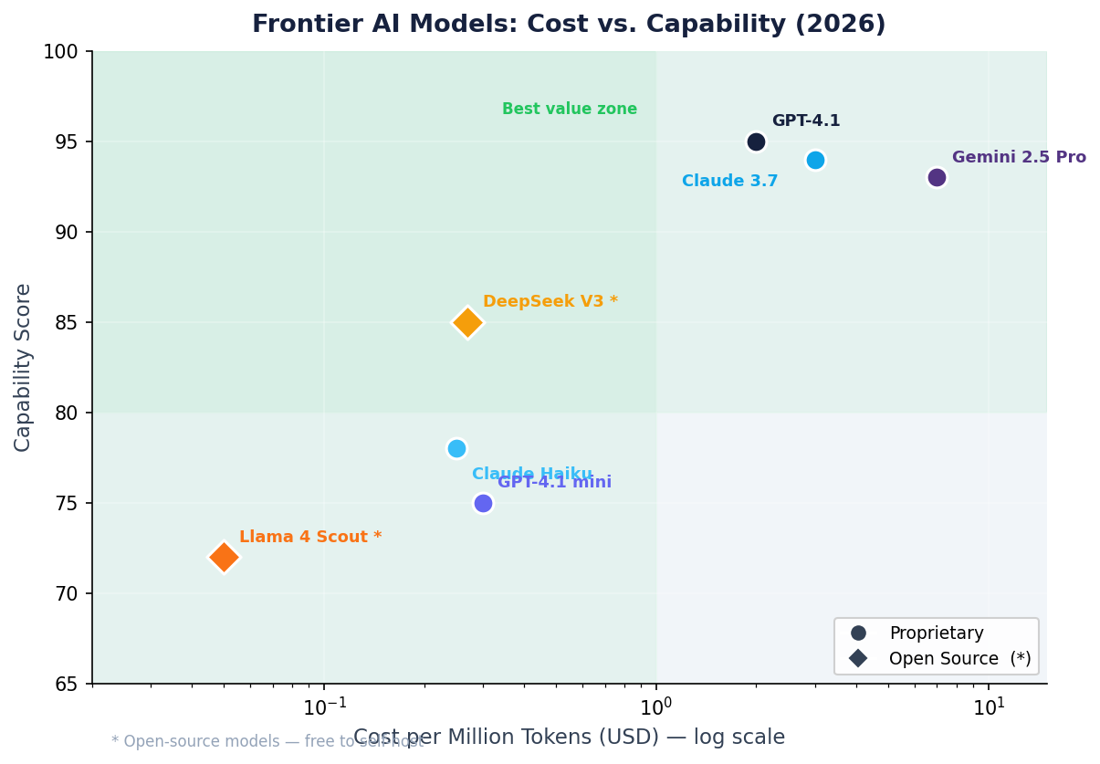
Frontier Models — The Big Three in 2026
OpenAI, Anthropic, Google: What's New and Why It Matters
OpenAI — Reasoning at Scale
Model | Capability | Best For | Cost
GPT-4.1 | Best general-purpose, fast | Everyday tasks, broad applications | ~$2–8/M tokens
o3 | Deep reasoning, thinks before answering | Math, complex logic, multi-step analysis | ~$15/M tokens
o4-mini | Near-o3 quality, 10× cheaper | Reasoning tasks at scale | ~$1–3/M tokens
Anthropic — Coding and Long Context
Google — Multimodal and Massive Context
Key 2026 shift: The capability gap between providers has narrowed dramatically. The decision framework is no longer "which is best?" — it's "which fits my specific task, data requirements, and budget?"
4

Slide 6
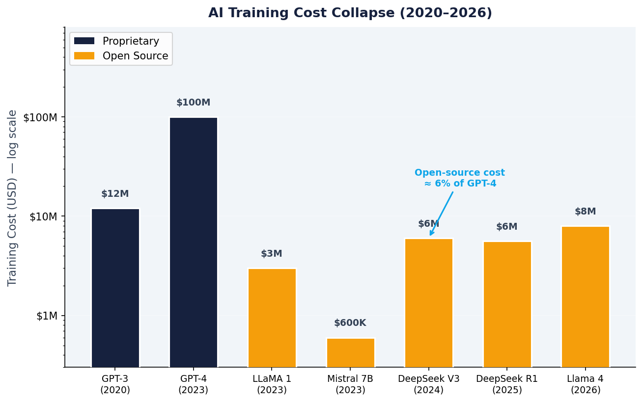
The Open Source Revolution
DeepSeek, Llama, Mistral — Why This Changes Everything
The January 2025 Inflection Point: The DeepSeek Moment
DeepSeek (a Chinese AI lab) released two open-source models in early 2025 that matched the best proprietary models — trained for a reported $6 million, compared to hundreds of millions spent by OpenAI and Google. The market reacted: NVIDIA's stock dropped 10% in one day.
Leading open-source models as of April 2026:
Model | Creator | Size | Benchmark vs. Proprietary | Can Run Locally?
Llama 4 Scout | Meta | 17B active (109B total MoE) | Matches GPT-4o on most tasks | Yes (requires 24GB+ GPU)
DeepSeek V3 / R1 | DeepSeek | 671B (MoE) | V3 ≈ GPT-4o; R1 ≈ o1 | Via API or self-hosted
Mistral Large 2 | Mistral AI | 123B | Strong multilingual, coding | Via API or self-hosted
Qwen 2.5 / QwQ-32B | Alibaba | 7B–72B | QwQ-32B strong reasoning | Yes — runs on consumer GPU
Phi-4 | Microsoft | 14B | Outperforms models 5× larger | Yes — runs on a laptop
What open source unlocks for business:
• Privacy: Entire pipeline stays inside your infrastructure — no data sent to any cloud provider
5

Slide 7
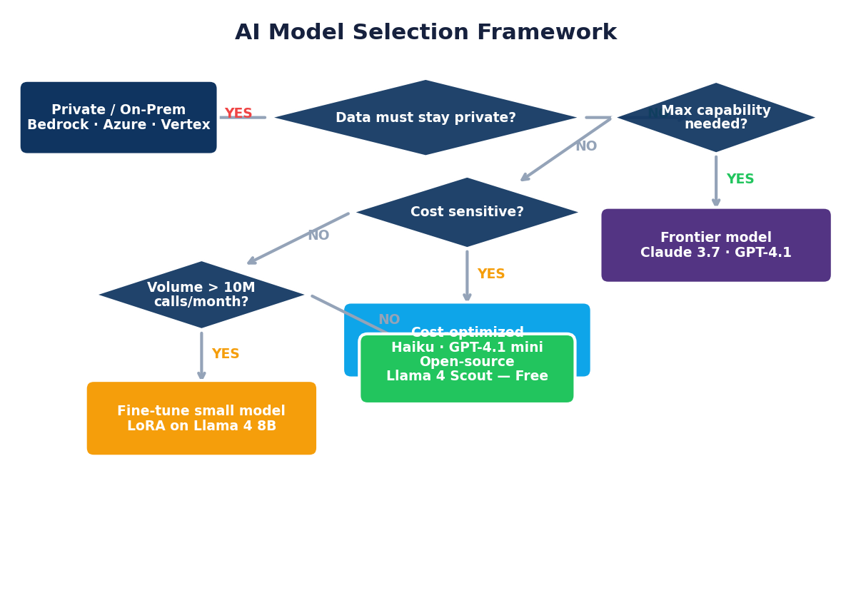
Choosing the Right Model — Decision Framework
A Systematic Approach for Business Use Cases
Step 1: Match capability to task type
Task Category | Top Choice | Runner-Up | Why
Complex reasoning & analysis | Claude 3.7 / o3 | Gemini 2.5 Pro | Step-by-step thinking, high accuracy
High-volume text processing | Gemini 2.0 Flash | GPT-4.1-mini | Cheap + fast at scale
Software development & coding | Claude 3.7 Sonnet | GPT-4.1 | Consistently #1 on coding benchmarks
Very long documents (>100K words) | Gemini 2.5 Pro | Claude 3.7 | 1M token context window
Sensitive / regulated data | Llama 4 / Phi-4 (local) | Mistral (self-hosted) | Data never leaves your infrastructure
Step 2: Apply constraint filters
• Is data sensitive or regulated? → Self-hosted open source (Llama, Phi-4, Mistral)
• Is cost per call the primary constraint? → Flash / Haiku / o4-mini tier
• Does quality of reasoning matter most? → o3, Claude 3.7 extended thinking, Gemini 2.5 Pro
6

Slide 8
Section 2
AI Agent Frameworks & MCP

Slide 9
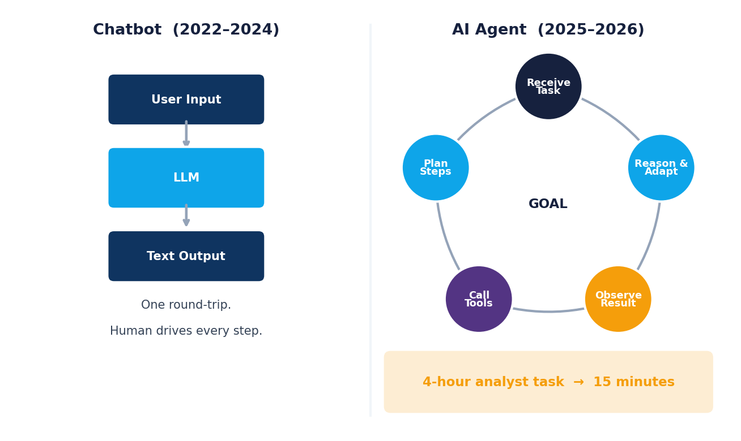
The Rise of Agentic AI
From "Answer Me" to "Do This For Me"
The fundamental shift:
Dimension | Chatbot (2022–2024) | AI Agent (2025–2026)
What you give it | A question | A goal or task
What it returns | Text | A completed result
How it works | One round of input/output | Plans, uses tools, iterates, adapts
Memory | Single session only | Persistent across steps and sessions
Tools available | None (or limited search) | Web, code execution, files, APIs, databases, email
The agent loop — how every agent framework works:
• Receive the task and break it into steps
• Select the right tool for each step
• Execute the tool call and observe the result
7

Slide 10
Anthropic Claude Agent SDK
Building Production Agents with Claude
What makes the Claude Agent SDK powerful:
• Tool use: Define any Python function as a tool — the model decides when and how to call it
• Extended thinking: Claude reasons step-by-step before using tools, reducing errors on complex tasks
• Computer use: Claude can control a real browser — click, type, navigate, take screenshots
• Multi-agent: Spawn sub-agents for parallel tasks; orchestrate teams of specialized Claudes
• Long context: 200K tokens of working memory — entire codebases, long documents, conversation history
Core pattern — tool definition and agent loop:
8

Slide 11
OpenAI Agents SDK
Four Primitives for Production Agentic Systems
Released in early 2025 — designed for enterprise deployments
The OpenAI Agents SDK is built around four composable primitives that map cleanly to real business workflow patterns:
Primitive | What It Is | Business Example
Agent | An LLM with a role, instructions, and tools | "Tier-1 Support Agent" with access to your knowledge base
Handoff | Transfers control to a specialist agent | Escalate complex issues to "Billing Specialist Agent"
Guardrail | Validates inputs and outputs against rules | Block PII from leaving the system; enforce safe responses
Tracing | Full audit log of every agent decision and tool call | Required for compliance in finance and healthcare
Code pattern — multi-agent handoff:
Key differentiators vs. other frameworks:
• Native integration with OpenAI Assistants API (persistent threads, file attachments)
• Built-in tracing dashboard — see every step your agent took
• Guardrails run in parallel, not sequentially — no added latency
9

Slide 12
Google ADK and LangGraph
Enterprise Orchestration and Complex Control Flow
Google Agent Development Kit (ADK)
Designed for organizations already on Google Cloud — tightly integrated with Vertex AI, Google Search, Google Workspace, and enterprise compliance infrastructure.
Feature | Detail
Model | Gemini 2.0 Flash / Pro — native, no adapter needed
Tools | Google Search, Maps, Drive, Gmail, Calendar — all native
Multi-agent | Hierarchical: agents delegate to sub-agents automatically
Sessions | Persistent state management across user conversations
Deployment | Vertex AI — enterprise billing, SOC2, HIPAA, regional data
Evaluation | Built-in eval framework for measuring agent quality
LangGraph — Workflows as Graphs
LangGraph models agent behavior as a directed graph: nodes are processing steps, edges are transitions. This enables patterns that linear chains cannot handle:
• Cycles: Retry a step if quality is insufficient; iterate until criteria are met
• Parallel branches: Run research and data analysis simultaneously; merge results
• Human-in-the-loop: Pause execution at a "human review" node; resume when approved
10

Slide 13
CrewAI — Role-Based AI Teams
The Consulting Firm Model for AI
The core insight behind CrewAI: Complex knowledge work is done better by a team of specialists than by one generalist — even when all the "people" are AI.
A researcher produces different quality work than a writer. An analyst reasons differently than a strategist. CrewAI makes this explicit: you define a team with roles, goals, and backstories — and the agents actually perform differently as a result.
Full example — competitive intelligence workflow:
from crewai import Agent, Task, Crew, Process
researcher = Agent(
role="Senior Market Research Analyst",
goal="Find accurate, data-backed competitive intelligence",
backstory="""You are a veteran analyst at McKinsey & Company.
You cite specific numbers and sources. You never speculate.""",
tools=[web_search, company_database, news_api],
verbose=True
)
analyst = Agent(
role="Strategic Analyst",
goal="Draw actionable insights from raw research data",
Real production deployments today: Automated RFP responses (one agent per requirement section), daily competitive intelligence briefings, M&A due diligence workflows, content production pipelines
11

Slide 14
MCP — Model Context Protocol
The Universal Standard for AI Tool Integration
The problem MCP solves:
Before MCP (pre-late 2024), every AI application needed custom integrations for every data source. A team using Claude needed one custom integration for their database, another for Slack, another for GitHub, another for their CRM. Multiply this by dozens of tools and dozens of AI products — every vendor reinventing the same connections in incompatible ways.
MCP's solution: One open standard, like USB-C for AI. Build an MCP server once; any MCP-compatible client can use it.
How MCP works:
Component | Role | Example
MCP Server | Exposes data/tools via the standard protocol | Your PostgreSQL database as an MCP server
MCP Client | AI application that connects to servers | Claude, Cursor, any LLM app
MCP Protocol | The standard that connects them | JSON-RPC over stdio or HTTP
MCP servers available today (April 2026):
Why MCP matters for your career: If you build an MCP server for your company's internal tools, that integration works with every MCP-compatible AI product — now and in the future. One investment, compounding returns as the ecosystem grows.
12

Slide 15
Building Your First Agent — The Pattern
The Code Architecture Every Agent Uses
Every agent framework — regardless of provider — implements this same fundamental loop:
import anthropic, os
client = anthropic.Anthropic()
# 1. DEFINE TOOLS: Tell the model what capabilities it has
tools = [
{
"name": "fetch_webpage",
"description": "Fetch visible text from a URL. Use for research.",
"input_schema": {"type": "object",
"properties": {"url": {"type": "string"}},
"required": ["url"]}
},
{
"name": "save_report",
Three things to understand about this pattern:
• The model reads the tool descriptions and decides when to call them — you never tell it which tools to use
• The loop continues until stop_reason == "end_turn" — the model signals when it's done
• Any Python function you can write becomes a tool — databases, APIs, email, file system, anything
This is the foundation. Every framework (LangGraph, CrewAI, OpenAI Agents) is an abstraction on top of exactly this loop.
13

Slide 16
Section 3
AI Coding Tools

Slide 17
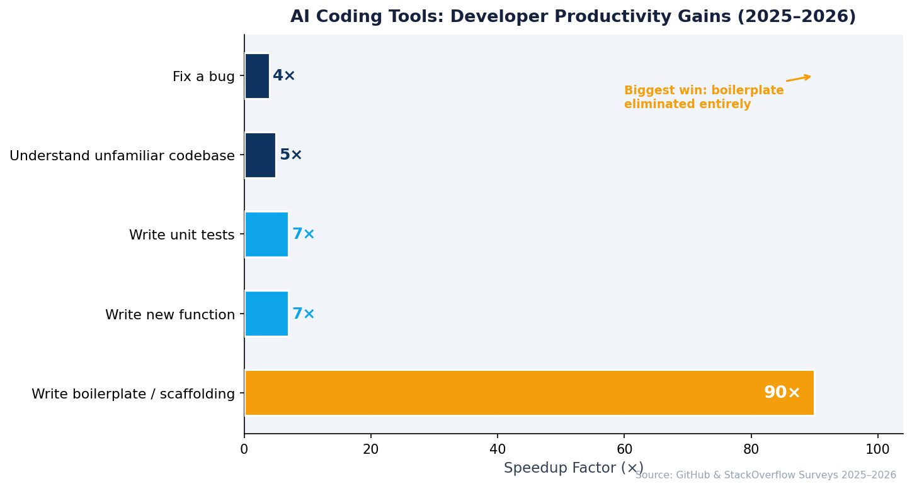
The AI-Powered Development Revolution
What Changed in 24 Months
The productivity data (GitHub, StackOverflow surveys, 2025–2026):
Development Task | Without AI | With AI Tools | Speedup
Write a new function | 15 min | 2 min | 7×
Fix a bug | 30 min | 8 min | 4×
Write boilerplate / scaffolding | 45 min | 30 sec | 90×
Understand an unfamiliar codebase | 2 weeks | 3 days | 5×
Write unit tests | 20 min | 3 min | 7×
The before/after for business analytics professionals:
Before (2022): Write every line manually. Google for syntax. Stack Overflow for debugging. 70% of coding time on boilerplate, lookups, and mechanical fixes.
After (2026): Describe what you want. Review and validate what AI produces. Focus on logic, architecture, and business problem framing. AI handles the execution details.
What this changes about skills:
14

Slide 18
Claude Code — The Agentic Terminal
Anthropic's CLI Coding Agent
What makes Claude Code fundamentally different from Copilot-style tools:
Dimension | Claude Code | IDE Autocomplete Tools
Interface | Terminal CLI — works anywhere | IDE plugin — tied to one editor
Scope of awareness | Your entire codebase | The file you're editing
Mode of operation | Completes full tasks end-to-end | Suggests what to type next
Actions it can take | Read files, write files, run tests, execute commands | Insert code suggestions only
Autonomy level | Full agent — plans and executes | Copilot — assists and waits
Best model | Claude 3.7 Sonnet (coding benchmark leader) | Varies by tool
How it works in practice:
Real task examples Claude Code completes autonomously:
• "Add error handling and retry logic to all API calls in the src/api/ directory"
• "Write pytest unit tests for the UserService class, covering edge cases"
• "Refactor the authentication module to use JWT tokens instead of session cookies"
• "There's a bug in checkout.py — the discount isn't applied when cart > $500. Fix it."
15

Slide 19
Cursor — The AI-Native IDE
VS Code Rebuilt for AI-Assisted Development
Why Cursor is the most popular AI coding tool among professional developers (2025–2026):
Cursor didn't bolt AI onto an existing editor — they forked VS Code and rebuilt every layer with AI as a core primitive. The AI has access to your full project structure, open files, terminal output, and git history. This context depth is what separates Cursor from plugins.
The four features that matter:
Feature | How It Works | What It Unlocks
Tab Completion | Completes entire functions, not just lines. Understands the surrounding code's intent. | 3–5× faster for function and class writing
Chat (Ctrl+L) | Conversational AI with @-mention context. @UserService pulls that file into context. | Navigate and understand large codebases instantly
Composer / Agent Mode | Give a task, not a line. Plans, writes, runs terminal commands, iterates. | Autonomous multi-file implementation
Cursor Rules | Project-level instructions: style guides, conventions, framework choices, test requirements. | Consistent AI behavior across your whole team
Pricing tiers:
Student recommendation: Pro at $20/month. If you write Python for data work, this pays for itself in the first hour of use.
16

Slide 20
Windsurf — The Cascade Agent
Long-Horizon Autonomous Coding
Windsurf, built by Codeium, launched in late 2024 with a different philosophy than Cursor: instead of optimizing for how fast you can type, optimize for how complex a task AI can complete without you touching the keyboard.
The Cascade Agent — what makes it distinct:
• Maintains a coherent understanding of the whole goal across many steps — not just the current task
• Decisions made in step 10 are consistent with decisions made in step 2
• Rewrites across many files stay architecturally consistent
• Better at greenfield builds (starting from scratch) than at incremental edits to existing code
Feature comparison:
Feature | Cursor | Windsurf
Base editor | VS Code fork | VS Code fork
Agent name | Composer | Cascade
Model options | GPT-4o, Claude 3.7, Gemini | Claude 3.7, GPT-4o, Gemini
Free tier | 2,000 completions, limited chat | More generous — 5 Cascade flows/day + unlimited autocomplete
Unique strength | Deep context on existing codebases | Coherent long-horizon task execution
Best for | Working on mature, complex projects | Building new features and services from scratch
Pricing (Pro) | $20/month | $15/month
17

Slide 21
GitHub Copilot and Enterprise AI Coding Tools
The Enterprise Standard and the Ecosystem
GitHub Copilot in 2026 — beyond autocomplete:
Feature | What It Does | Business Value
Copilot Autofix | Scans code for security vulnerabilities; generates fixes automatically | Reduces CVE backlog without dedicated security sprints
Copilot Workspace | Takes a GitHub Issue, plans the implementation, proposes code changes | From ticket to PR without opening an IDE
Copilot in PRs | Reviews every pull request, suggests improvements, summarizes changes | Every PR gets an AI review pass before human reviewers
Copilot Chat | Conversational AI about any codebase — ask architecture questions, debug issues | Junior developers onboard faster; seniors stay in flow
Copilot Extensions | Connect Jira, Datadog, Sentry, and 30+ tools directly into the chat interface | One AI interface for your entire toolchain
Why enterprises choose Copilot: It's not always the most capable agent — it's where the code already lives. GitHub manages the org's entire codebase, PR history, and issue backlog. Copilot integrates there, not alongside it.
The broader enterprise AI coding ecosystem:
Free access for students: GitHub Copilot Pro is included in the GitHub Student Developer Pack at no cost. Apply at github.com/education with your UTD email.
18

Slide 22
AI Coding Tools — Full Comparison and Decision Guide
Choosing the Right Tool for Your Work
Head-to-head comparison:
Tool | Interface | Autonomy | Model Quality | Free Tier | Paid Tier | Best For
Claude Code | Terminal CLI | ★★★★★ | Claude 3.7 (best coder) | Pay-as-you-go | ~$20/mo typical | Agentic tasks, multi-file changes
Cursor | IDE (VS Code) | ★★★★☆ | GPT-4o, Claude, Gemini | 2,000 completions | $20/mo | Daily dev work, large codebases
Windsurf | IDE (VS Code) | ★★★★☆ | Claude, GPT-4o | 5 flows/day | $15/mo | New features, long tasks
GitHub Copilot | IDE + GitHub | ★★★☆☆ | GPT-4o | Yes (limited) | $19/mo | Enterprise, GitHub-integrated teams
Amazon Q | IDE + CLI | ★★★☆☆ | Claude-powered | Yes | $19/mo | AWS-native development
Replit AI | Browser | ★★☆☆☆ | GPT-4o | Yes (limited) | $20/mo | Learning, no-install prototypes
Decision guide by situation:
• In an enterprise with IT governance requirements → GitHub Copilot (approved vendor, SOC2, audit logs)
• Building Python data pipelines and analytics → Cursor or Claude Code
• Starting a new project from scratch → Windsurf Cascade for the first build
• Want maximum autonomy, hands-off task completion → Claude Code
• Student learning to code → Replit AI (browser, no setup) or Windsurf (generous free tier)
19

Slide 23
Section 4
Business Automation & Multimodal AI

Slide 24
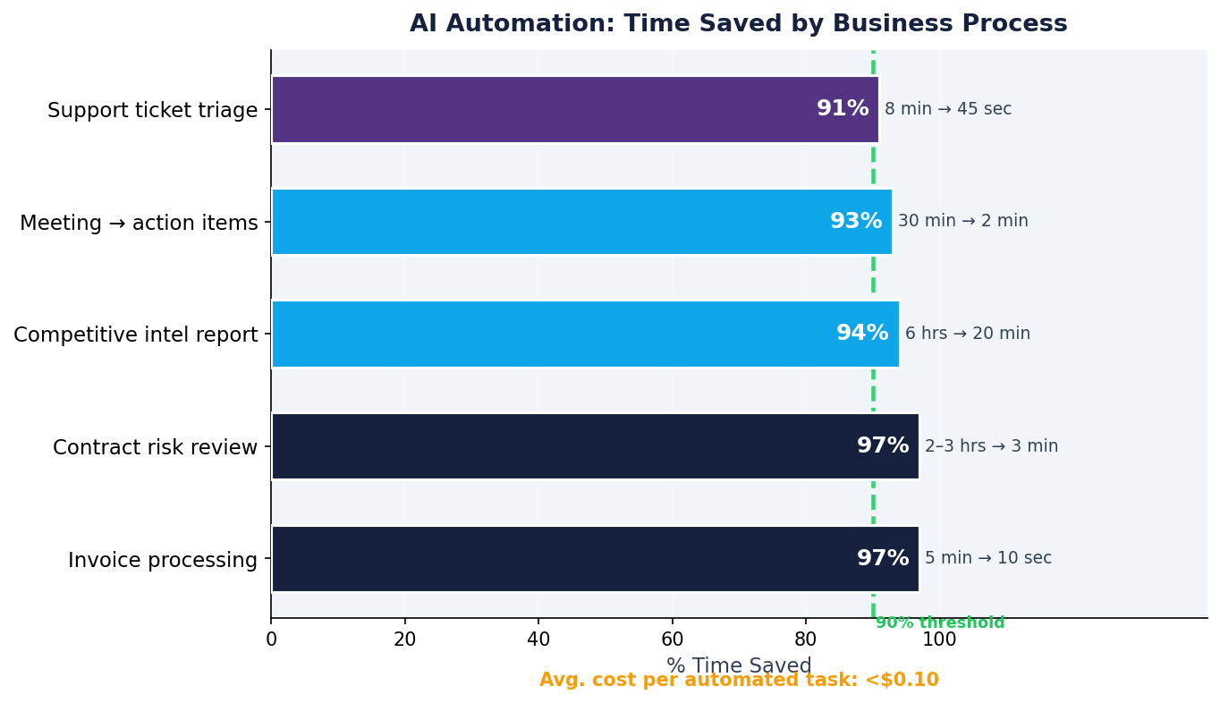
AI Business Automation — The Convergence
When Workflow Automation Meets Intelligence
Two technologies, each powerful alone — together, transformative:
Traditional Automation (Zapier/Make/n8n) | AI (LLMs, Vision, Voice)
Rule-based: if X then Y | Judgment-based: understand X, decide Y
Only handles structured data | Handles text, images, audio, documents
Brittle — breaks on edge cases | Adaptive — handles variation and ambiguity
"If email arrives → create ticket" | "Read email, understand intent, draft reply, route to right team"
Replaces mechanical steps | Replaces judgment steps
The resulting productivity impact — measured across 2025–2026 deployments:
The shift in what humans do: Professionals stop spending 70% of their time on gathering, extracting, formatting, and routing — and spend it instead on judgment calls, client relationships, and strategy. The work becomes higher-leverage, not just faster.
20

Slide 25
n8n — Open Source AI Automation
When Privacy and Flexibility Matter
n8n (pronounced "nodemation") is the open-source alternative to Zapier — self-hostable, developer-extensible, and with native AI integration built for production workloads.
Why organizations choose n8n over Zapier for AI workflows:
Criterion | n8n | Zapier
Data hosting | Self-hosted on your servers — data never leaves | All data flows through Zapier's US cloud
AI model support | Claude, GPT, Gemini, Ollama (local) — full choice | OpenAI + limited others
Cost at scale | Fixed server cost — unlimited operations | Per-operation pricing, expensive at scale
Customization | Full JavaScript/Python custom nodes | Limited to available integrations
Open source | Yes — auditable, forkable, extensible | No
Setup complexity | Medium (Docker, 30 minutes) | Low (browser, 5 minutes)
A production AI workflow in n8n — intelligent email routing:
• Trigger: New email arrives (Gmail / Outlook webhook)
• AI Agent Node (Claude): Read full email → classify as [Sales / Support / Billing / Internal / Spam] → extract key information (sender intent, urgency, required action, deadline)
• Branch by classification:
› Sales → Create HubSpot lead → Notify sales channel in Slack with AI summary
21

Slide 26
Make and Zapier — No-Code AI Automation
The Tools Your Non-Technical Colleagues Are Already Using
Make (formerly Integromat) — Visual, Flexible, Powerful
Make's scenario builder is a visual flowchart: modules are connected with wires, data flows are visible, and branching logic is explicit. It occupies the middle ground between Zapier's simplicity and n8n's technical depth.
Make AI features added in 2025:
Feature | What It Does | Business Example
AI Scenario Builder | Describe what you want in natural language → Make builds first draft | "When a form is submitted, classify it and email the right department"
OpenAI / Claude Module | LLM step in any scenario | Summarize, classify, extract, generate — anywhere in the flow
AI Data Transform | "Convert this messy incoming JSON to this clean format" — no regex needed | Normalize data from 5 different vendors into one schema
Make AI Chat | Conversational debugging — "Why did this scenario fail?" | Reduce troubleshooting time from hours to minutes
Pricing: Free (1,000 ops/mo) · Basic $9/mo · Pro $16/mo · Teams $29/mo
Zapier — The Largest Integration Ecosystem
7,000+ app integrations. The easiest setup. The most non-technical-friendly interface. And in 2024–2025, Zapier added AI across the entire platform:
Tool selection guide:
22

Slide 27
Multimodal AI — Vision and Audio in Business
The Business Data That Wasn't Accessible — Now Is
The shift: In 2022, AI worked on text. By 2026, leading models natively process text, images, PDFs, audio, and video in a single API call. This unlocks enormous amounts of previously inaccessible business data.
Vision AI — what's production-ready today:
Capability | Best Model | Business Application | Accuracy Level
Invoice / receipt extraction | GPT-4o, Claude 3.7 | Extract vendor, amount, date, line items → structured JSON | 95–98% on clean scans
Contract / legal document review | Claude 3.7 (200K ctx) | Flag risky clauses, extract dates, obligations | Strong — needs human review for legal decisions
Dashboard / chart reading | Gemini 2.5, GPT-4o | "What does this chart tell us? What's the trend?" | Very good on standard chart types
Product photo QA | Gemini 2.5 Pro | Flag defects, verify packaging, check planogram compliance | Varies by defect complexity
Screen / UI automation | Claude Computer Use | Click through any application, fill forms, extract data from GUIs | Production-ready for structured UIs
Audio AI — what's production-ready today:
23

Slide 28
Video Generation — Where Business Use Is Ready
What's Production-Ready vs. What Still Has Limitations
The 2026 state of AI video — platform comparison:
Platform | Creator | Max Length | Strengths | Weaknesses | Best Business Use
Sora | OpenAI | ~1 min | Highest photorealism, strong scene consistency | Expensive ($200/mo), limited control | Premium marketing, brand films
Runway Gen-3 | Runway | 10–30 sec | Film-quality, fine camera control, good motion | Short clips only | High-end social content
Google Veo 2 | Google | Several min | Long clips, photorealistic, API access | Limited availability | Enterprise video at scale
Kling 2.0 | Kuaishou | 2–3 min | Fast, good quality, generous free tier | Occasional consistency issues | Social media, product demos
HeyGen | HeyGen | Unlimited | AI talking-head avatars, multilingual | Presenters only, no scene generation | Training, onboarding, explainer videos
Synthesia | Synthesia | Unlimited | Enterprise-grade, 140+ languages, compliance | Template-based, less creative flexibility | Corporate training, L&D
What's genuinely production-ready for business in 2026:
• Training and onboarding videos (HeyGen / Synthesia): AI avatar presents content. Update the script → instantly regenerate. Translate to 30 languages at no added cost. Proven ROI: companies report 60–80% reduction in L&D video production time.
• Short-form marketing content: 15–30 second product clips, social media visuals, ad creative variants. Generate 20 variants in an hour for A/B testing. Cost: $0.50–$2.00 per clip.
• Product demonstration videos: Walk through software UI or product features. No reshooting when features change — regenerate from updated screenshots.
Current limitations (be honest with stakeholders):
• Clips longer than 2 minutes often have consistency issues
24

Slide 29
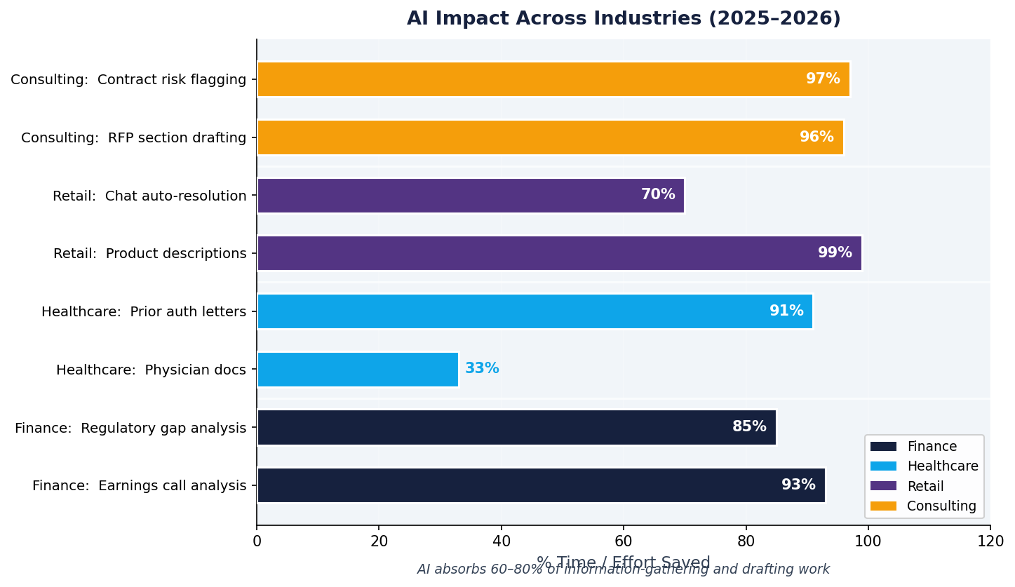
Industry Applications — Where AI Is Creating Measurable Value
Real Deployments, Real Numbers
Finance and Banking
Application | AI Tools | Measured Impact
Earnings call analysis and Q&A | Claude 3.7, GPT-4o | Analyst prep time: 2 hours → 8 minutes
Credit risk narrative generation | Fine-tuned LLM + RAG | Decision documentation: 40% faster
Regulatory gap analysis | Claude (200K context) | Compliance review: days → hours
Trade surveillance reports | LLM + structured ML | Alert investigation: 50% faster triage
Healthcare and Life Sciences
Retail and E-commerce
Consulting and Professional Services
The consistent pattern: AI absorbs 60–80% of the information-gathering and drafting work. Professionals shift their time to judgment, relationships, and quality control — higher-leverage activities. The job isn't eliminated; it's upgraded.
25

Slide 30
Section 5
Key Trends & Strategic Outlook

Slide 31
RAG in 2026 — Beyond Basic Retrieval
From Prototype to Production-Grade Knowledge Systems
What RAG does: Connects an LLM to your proprietary data so it answers questions grounded in your knowledge — policies, products, client history, research — not just its training data.
Why RAG beats fine-tuning for most knowledge use cases:
Criterion | RAG | Fine-tuning
Updates when data changes | Yes — re-index the new document | No — requires retraining
Cites sources | Yes — provenance is built in | No — model "knows" it but can't cite
Cost to implement | Low to medium | High
Time to production | Days to weeks | Weeks to months
Handles proprietary facts | Yes | Yes
Requires ML expertise | No | Yes
The 2025–2026 RAG improvements that matter for production:
Minimal production RAG stack (2026):
Cost benchmark: Indexing 1,000 documents ≈ $0.50. Answering a query ≈ $0.02–$0.10.
26

Slide 32
Fine-Tuning Accessibility in 2026
From Research Lab to Business Tool
Fine-tuning definition: Continue training a pre-trained model on your specific data — producing a model that reflects your domain language, output style, and task requirements.
When fine-tuning is the right answer (and when it isn't):
Scenario | Best Approach | Why
Need factual knowledge from your documents | RAG | Fine-tuning doesn't reliably memorize facts
Need consistent output format or writing style | Fine-tuning | Style is baked in — no per-call prompting needed
Domain-specific terminology and reasoning | Fine-tuning | Model learns your language, not just your content
Running 10M+ calls/month, cost is critical | Fine-tuning on a small model | Fine-tuned small model outperforms large model on your task at 1/10th the cost
Data is fresh / changes frequently | RAG | Re-indexing is instant; retraining is slow
What's accessible in 2026 — no PhD required:
OpenAI Fine-Tuning API (cloud):
LoRA / QLoRA (local, open source):
• LoRA: Trains a small adapter on top of frozen base weights — 90% fewer trainable parameters, same quality improvement
• QLoRA: LoRA + 4-bit quantization — fine-tune a 7B model on a single consumer GPU in 1–3 hours
27

Slide 33
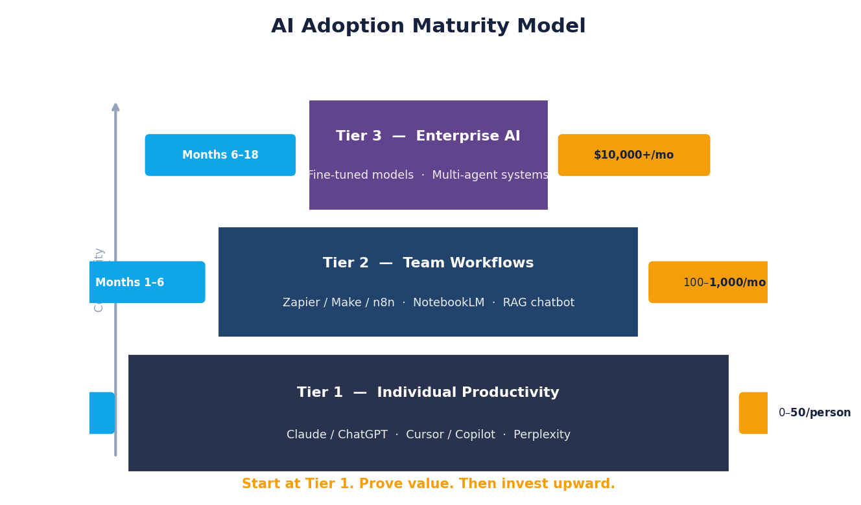
Building Your AI Stack — A Tiered Roadmap
From Individual Tools to Enterprise AI in 5 Steps
The three-tier maturity model:
Tier | What You Build | Tools | Monthly Cost | Timeline
Tier 1: Individual Productivity | Personal AI assistants for daily work | Claude/ChatGPT/Gemini, Cursor/Copilot, Perplexity | $0–$50/person | Start now
Tier 2: Team Workflows | Automated processes shared across the team | Zapier/Make/n8n, NotebookLM, RAG chatbot on your docs | $100–$1,000/month | Months 1–6
Tier 3: Enterprise AI | AI-native products and internal platforms | Fine-tuned models, multi-agent systems, AI-embedded products | $10,000+/month | Months 6–18
The five-step adoption playbook:
• Map: List your 10 most time-consuming, low-judgment repetitive tasks. These are automation candidates.
• Pilot: Pick 2–3. Use existing AI tools ($0 incremental cost) to assist with them for 2 weeks.
• Measure: Quantify time saved per task. Calculate weekly/monthly hours. Document quality differences.
28

Slide 34
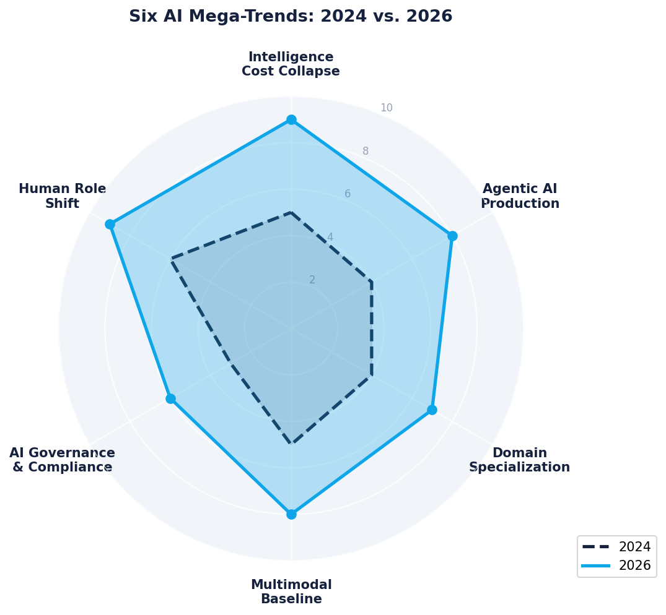
Six Trends Reshaping Business AI — 2026 and Beyond
What to Watch, What It Means for You
Trend 1: Intelligence cost collapses toward zero
• GPT-4 level in 2023: $60/million tokens → Today: $0.50–$2.00 → Projection 2027: $0.10 or less
• Implication: Cost is no longer the barrier to AI deployment — trust, integration, and governance are
Trend 2: Agentic AI moves from demo to production
• 2024: Impressive demos. 2025: Pilots. 2026: Production at scale at companies like Klarna, JPMorgan, Salesforce
29

Slide 35
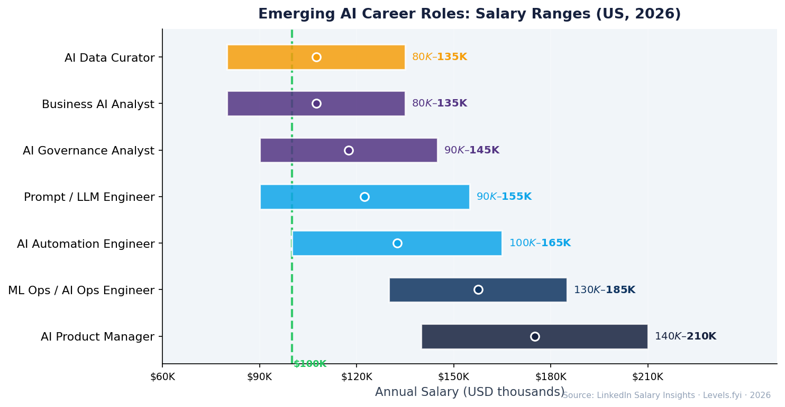
Career Opportunities in the AI Era
Where Business Analytics Students Fit in 2026
Roles that barely existed in 2022 — and are now in high demand:
Role | What They Do Day-to-Day | Salary Range (US) | Key Skill Stack
AI Product Manager | Define AI features, manage LLM-based products, write evals | $140–$210K | Product instinct + LLM behavior understanding
AI Automation Engineer | Build agent workflows, connect LLMs to business systems | $100–$165K | Python, LangChain/n8n, REST APIs, cloud
Prompt Engineer / LLM Engineer | Design prompts, build evals, optimize model behavior | $90–$155K | LLM internals, eval frameworks, domain expertise
AI Data Curator | Build training and evaluation datasets for fine-tuning | $80–$135K | Domain expertise + annotation tooling + quality metrics
ML Ops / AI Ops Engineer | Deploy, monitor, and maintain production AI systems | $130–$185K | Cloud, MLflow, monitoring, cost optimization
The five skills that compound most in this market:
• Python + API integration — the LLM API call is the fundamental unit of AI product development; everything builds on this
• RAG and vector databases — the backbone of every enterprise AI deployment; LlamaIndex, LangChain, ChromaDB, Pinecone
• Prompt design + evaluation — systematic, measurable approach to getting consistent AI outputs; not art, it's engineering
30

Slide 36
Class Wrap-Up — Your AI Landscape Map
Six Things to Walk Away Knowing
What today's class gave you:
1. The model landscape is rich, competitive, and fast-moving
GPT-4.1, Claude 3.7, Gemini 2.5, and open-source models like Llama 4 and DeepSeek all compete at the frontier. Choose by use case, data requirements, and cost — not by brand loyalty. The best model changes every 3–6 months.
2. Agents are the most important architectural shift since ChatGPT
Claude SDK, OpenAI Agents SDK, LangGraph, and CrewAI let you build AI that takes actions. MCP standardizes how agents connect to every tool in your stack. This is the category where the most value is being created right now.
3. AI coding tools are no longer optional for anyone who writes code
Claude Code, Cursor, Windsurf, and GitHub Copilot have moved from productivity boosters to competitive necessities. Writing code without AI assistance is increasingly a disadvantage, not a preference.
31

